Slide 1
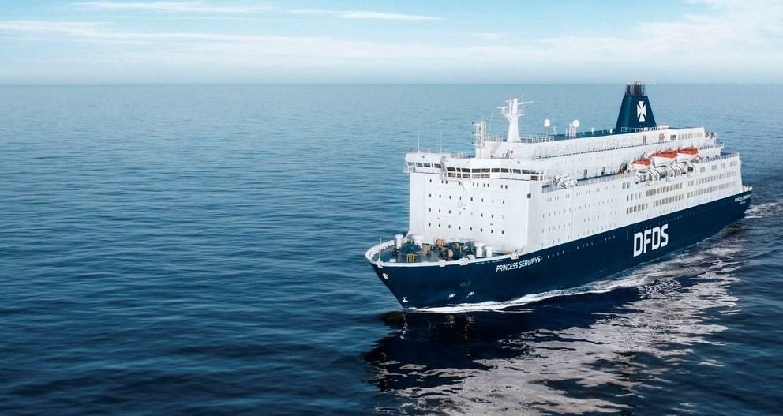
Ferry Shipping Webinar
Thursday 25th February at 15:00
Kasper Moos

Slide 2
How to restart the passenger ferry traffic?
As an industry we will need to present a consistent level of quality/cleanliness/protocol that cements a public’s perception that Ferry Travel is safe.
    This may require us to work together in ways that we have not done previously
We MUST restart at a lower cost-base, with improvements to our system that allow us to scale-up and down flexibly.
We need to focus on value selling & “transportation products”
    Evidence from 2020 was very clear that trying to stimulate demand by discounting did not fuel recovery
    Ferry companies will need to work with destinations to ensure they are open for business
    We have seen some evidence in Summer 2020 of a consumer preference for packages
The future will be different that the past, and we should plan accordingly
    There will be less long-haul travel in the first instance, and many short-haul airlines will not come back into the market
    Lead times will be shorter than what we are used to, and customers will expect more flexibility in booking conditions
    Government restrictions/advice/policy will create different demand for our various travel corridors
  25/02/2021 Kasper Moos, Vice President, DFDS A/S

