Slide 1
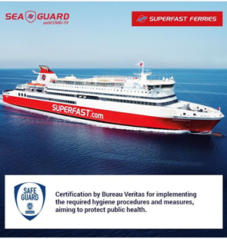
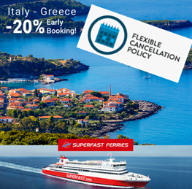
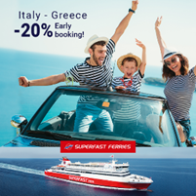
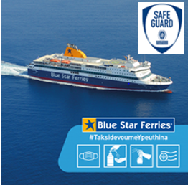
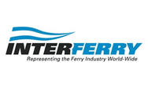
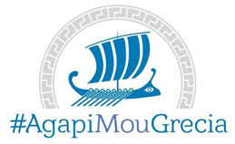
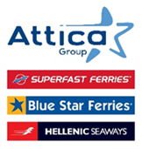
How to restart the passenger ferry traffic?
“SAFEGUARD” by Bureau Veritas
Knowledge is our Shield
Flexibility, Behavioral changes
Travellers feel safer in the comfort and safety of their own car
Interferry Guidelines
#AgapiMouGrecia
The Attica Group fleet consists of 32 modern and technologically advanced conventional and high speed vessels, providing high quality transportation services for passengers, private vehicles and rolling cargo. It serves 60 destinations and connects 71 ports in the Greek domestic market, and on the international routes between Greece - Italy and Morocco - Spain, through the brands of Superfast Ferries, Blue Star Ferries, Hellenic Seaways and Africa Morocco Link (AML).

