Slide 1
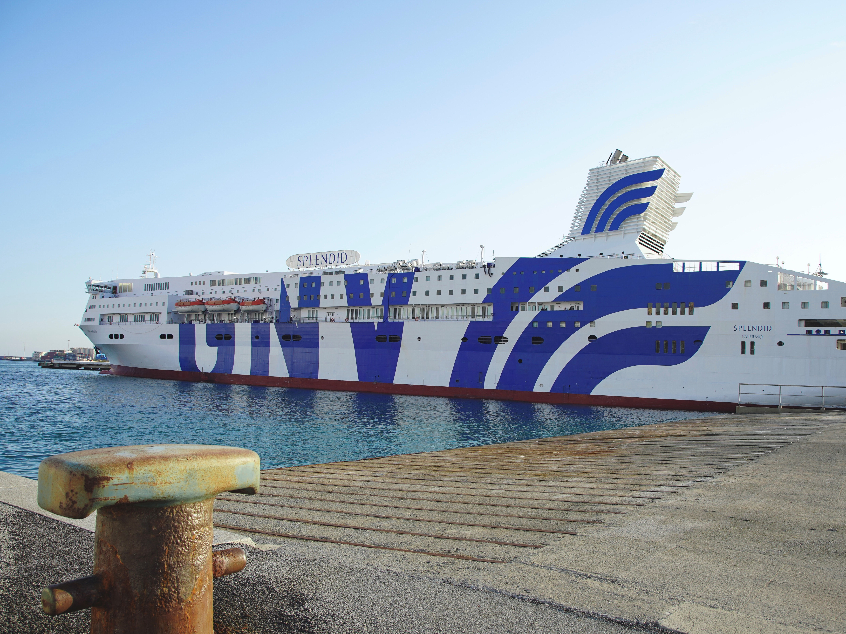

17 vessels
11 international connection
8 domestic connection
6 countries
14 ports
GNV part of the MSC Group, started working on the project together with RINA since the arising of the emergency, at the beginning of March 2020.
The project has been developed in close coordination with the Regional Health System and with the Civil Protection in a very short time.
The aim of the Hospital Vessel was to assist hundreds of potential patients, thus increasing the hospital capacity of Liguria and, where necessary also of other areas of the country.
GNV implemented its procedures for sanitation and social distancing on board, as well as in ticket offices and offices: in May, the Company adopted the Safety Services Charter, drawn up on the basis of the unique experience acquired with the project "hospital ship" held in Genoa to face the COVID-19 emergency, based on specific indications received by the health authorities
GNV has implemented a common protocol, together with other international operators, with the aim of qualifying ferry transport as a "safe corridor".
The “safe corridor” will be realized by reducing the probability of spreading the virus on board, through rigorous pre-screening tests, social distancing areas, cabins configured with independent external ventilation.
Safety: Customer Safety Charter and the Biosafety Trust Certification
Investments: continued growth in terms of new lines (Civitavecchia – Olbia) and vessel (GNV Sealand)
Communication: cohesion of the Industry sector to communicate same key safety factors as on-board spaces, access control, etc.
MARCH 2020
MAY 2020
JUNE 2020
JANUARY 2021
The Hospital Ship is a project developed by the ferry company GNV for the Ligurian regional health system, which involved the transformation of M/n Splendid into a fully equipped structure suitable to provide assistance to COVID-19 patients during the process of hospital discharge, for whom it was necessary to spend a period in a controlled structure before returning to their homes&families.
In particular, the ship allows the isolation of the individual cabins, all configured with totally independent external ventilation.
GNV has obtained the RINA Biosafety Trust Certification.
This innovative certification scheme was implemented by RINA, which verifies with rigorous periodic audits the application of the management systems, aimed at preventing the onset of bacterial and viral infections, but also aimed at containing their spread should a case be found during the travel experience, in order to guarantee the safety for passengers, employees and crew.
The Customer Safety Charter and the Biosafety Trust Certification therefore are a coordinated system for the prevention and management of contagion risks, in line with the OHSAS 18001 safety management standard and the HACCP hygiene management protocol.
The ferry is the safest travel solution: it combines the need to ensure public health and mobility.
It is impossible to guarantee social distancing on other means of transport due to obvious lack of space.

